Slide 1

Optimize Azure Synapse SQL Pools
{ |  | }
 | Azure Synapse SQL Pools

Slide 2
Workload Management
Module 7

Slide 3
Learning Units covered in this Module
Lesson 1: Introduction to Workload Management
Lesson 2: Workload Groups
Lesson 3: Workload Importance
Lesson 4: Workload Isolation
Lesson 5: Workload Classification
Lesson 6: Workload Management Monitoring

Slide 4

Objectives
After completing this lesson, you will be able to:
Understand the following topics:
Resource Management
Workload Management concepts and how it works
How concurrency works
Workload importance and how it affects resources

Slide 5
Lesson 1: Introduction to Workload Management

Slide 6
Resource Management
Legacy “Resource management:”
Resource classes:
Classifier:
Dynamic | Static
smallrc | staticrc10
mediumrc | …
largerc | staticrc80
xlargerc
sp_addrolemember @rolname, @membername
EXEC sp_addrolemember @rolname = ‘mediumrc’
,@membername = ‘User1’
Notes:
<you can hide & skip this slide if the customer does not currently use resource classes. No reason to teach them the wrong way of configuring this unless they already do it>
The legacy form of resource management was through the assignment of resource classes. This was based on the idea of “concurrency slots” and how many slots each query in a particular resource class would consume. There were dynamic and static resource classes and membership was controlled through SP_Addrolemember. Although similar in some ways to workload groups, the new method of workload management is much more powerful.
The newer method adds a lot more features and flexibility and gets away from the “concurrency slots” idea – replaced by a simple % of total resources. With concurrency slots, you had to be aware how many concurrency slots you had in a particular SLO, but since we moved to percentage you know the max is always 100% and you can take a chunk of that for each query.
Resource classes still exist for backwards-compatibility, they are now implemented as system workload groups. If you view the dmv sys.workload_management_workload_groups you will see all of the resource classes listed with the percentage resources methodology. It is recommended that you move away from these default workload groups and manage most of your queries in custom workload groups.

Slide 7
Workload Management Concepts
Workload Groups
Workload Importance
Workload Isolation
Workload Containment
Workload Classification
Workload Management
Workload Importance
Workload Group assignment
Notes:
Successful workload management scheme effectively manages resources, ensures highly efficient resource utilization, and maximizes return on investment (ROI).
Solution Architects seek ways to separate classic data warehousing activities (such as loading, transforming, and querying data) to ensure that enough resources exist to hit SLAs.
The data warehouse workload encompasses:
The entire process of loading data into the warehouse
Performing data warehouse analysis and reporting
Managing data in the data warehouse
Exporting data from the data warehouse
Synapse SQL pool workload management in Azure Synapse consists of a few high-level concepts: Workload Classification, Workload Importance, Workload Isolation, and workload containment. These capabilities give you more control over how your workload utilizes system resources.
https://docs.microsoft.com/en-us/azure/synapse-analytics/sql-data-warehouse/sql-data-warehouse-workload-management
Workload groups are the component that actually dictates how many resources a particular query gets. Workload classification is used to assign workload groups to a particular query or set of queries.

Slide 8
Lesson 2: Workload Groups

Slide 9
Workload Groups
MIN/CAP percentage resource
Request min/max resource grant
Importance
Query Execution Timeout
MIN/Cap of resources for all queries in the group
Amount of resources granted to each individual query in the group
Scheduling priority
Kill queries after a certain execution time
Notes:
When you create a workload group, you can describe the min/max resources for all queries in the workload group and you can also specify how many resources each request within the group gets. How these numbers are configured determines your concurrency within the workload group. You can set the importance for queries in the workload group as well, which will affect scheduling priority of incoming queries in the queue. You can also set a query execution timeout for a group. This may be useful if you have, say, user sandbox queries that should never be especially large queries unless the query was poorly written. If these are considered low-priority queries, you can set up an execution timeout to kill them to limit their impact on the rest of the system resources.
MIN/CAP percentage resource
Setting a MIN here should be carefully considered as it is a permanent allocation of resources to this workload group as long as the workload group exists – regardless of whether or not there are running queries. We will discuss this more in workload isolation.
Capping a workload groups overall resources prevents this workload group of using more concurrency resources within the service than intended.
Request min/max resource grant
These numbers are used to set the concurrency within a workload group.
New queries will always attempt to allocate the ‘MAX’ number identified unless there are not enough resources available in the resource class.
When it cannot allocate the MAX number would be:
The MAX number is higher than the ‘CAP_PERCENTAGE_RESOURCES’ specified for the overall workload group
Multiple queries are queued waiting for resources. It will split available resources among the queued queries, but guarantee at least the Minimum number is met
Query execution timeout only takes affect after the query has actually started executing and does not include time spent sitting in the queue.

Slide 10
Concurrency in Action
Workload Group
MIN_PERCENTAGE_RESOURCE: 0
CAP_PERCENTAGE_RESOURCE: 12
REQUEST_MIN_RESOURCE_GRANT_PERCENT: 2
REQUEST_MAX_RESOURCE_GRANT_PERCENT: 5
Request 1: Executing 5%
Request 2: Executing 5%
Request 3: Executing 2%
Request 4: Queued
Request 5: Queued
Request 6: Queued
Notes:
In this animation we will go through what it looks like when you have more queries than concurrency resources available. Each box represents 1% of resources. The service will attempt to specify the max resources available – up to the REQUEST_MAX_RESOURCE_GRANT_PERCENT. Whenever it does not have enough resources available to allocate the max, it will allocate as much as possible between the MIN and MAX Specified. If there are multiple queries in the queue, it will reduce each resource grant for maximum concurrency
In the example,
MIN_PERCENTAGE_RESOURCE is 0, which means we do not guarantee that resources are always available for this workload group (workload isolation).
CAP_PERCENTAGE_RESOURCE is set to 12%. This guarantees that queries in this workload group cannot use more than 12% of overall service resources.
REQUEST_MIN_RESOURCE_GRANT_PERCENT: 2%. This means that a query will not begin executing unless at least 2% of resources are available. So if at any point 1% of resources open up while a query is queued, it will remain queued until at least 2% of resources are available.
REQUEST_MAX_RESOURCE_GRANT_PERCENT: 5%. This is the percentage of resource that will be attempted to be allocated to any given query if the resources are available and it does not hinder other queued queries from executing. As you will see in the animations, It will execute using the max % of resources available, which is why some queries execute with 3% resources when that amount of resources is available.
A note on request 5: when request 5 starts execution there is 3% available and another query waiting in the queue. Because this query executing at the minimum 2% only opens up 1% of resources and would not allowed the last queued query to execute, there is no reason for it not to take that extra 1% for itself. If lowering request 5’s resource allocation would have left 2% of resources open and allowed request 6 to execute at the same time, it would have done that.

Slide 11
Concurrency in Action
Workload Group
MIN_PERCENTAGE_RESOURCE: 0
CAP_PERCENTAGE_RESOURCE: 12
REQUEST_MIN_RESOURCE_GRANT_PERCENT: 2
REQUEST_MAX_RESOURCE_GRANT_PERCENT: 5
Request 2: Executing 5%
Request 3: Executing 2%
Request 4: Executing 2%
Request 5: Executing 3%
Request 6: Queued
Notes:
In this animation we will go through what it looks like when you have more queries than concurrency resources available. The service will attempt to specify the max resources available – up to the REQUEST_MAX_RESOURCE_GRANT_PERCENT. Whenever it does not have enough resources available to allocate the max, it will allocate as much as possible between the MIN and MAX Specified. If there are multiple queries in the queue, it will reduce each resource grant for maximum concurrency
In the example,
MIN_PERCENTAGE_RESOURCE is 0, which means we do not guarantee that resources are always available for this workload group (workload isolation).
CAP_PERCENTAGE_RESOURCE is set to 12%. This guarantees that queries in this workload group cannot use more than 12% of overall service resources.
REQUEST_MIN_RESOURCE_GRANT_PERCENT: 2%. This means that a query will not begin executing unless at least 2% of resources are available. So if at any point 1% of resources open up while a query is queued, it will remain queued until at least 2% of resources are available.
REQUEST_MAX_RESOURCE_GRANT_PERCENT: 5%. This is the percentage of resource that will be attempted to be allocated to any given query if the resources are available and it does not hinder other queued queries from executing. As you will see in the animations, It will execute using the max % of resources available, which is why some queries execute with 3% resources when that amount of resources is available.
A note on request 5: when request 5 starts execution there is 3% available and another query waiting in the queue. Because this query executing at the minimum 2% only opens up 1% of resources and would not allowed the last queued query to execute, there is no reason for it not to take that extra 1% for itself. If lowering request 5’s resource allocation would have left 2% of resources open and allowed request 6 to execute at the same time, it would have done that.

Slide 12
Concurrency in Action
Workload Group
MIN_PERCENTAGE_RESOURCE: 0
CAP_PERCENTAGE_RESOURCE: 12
REQUEST_MIN_RESOURCE_GRANT_PERCENT: 2
REQUEST_MAX_RESOURCE_GRANT_PERCENT: 5
Request 4: Executing 2%
Request 2: Executing 5%
Request 3: Executing 2%
Request 6: Executing 3%
Notes:
In this animation we will go through what it looks like when you have more queries than concurrency resources available. The service will attempt to specify the max resources available – up to the REQUEST_MAX_RESOURCE_GRANT_PERCENT. Whenever it does not have enough resources available to allocate the max, it will allocate as much as possible between the MIN and MAX Specified. If there are multiple queries in the queue, it will reduce each resource grant for maximum concurrency
In the example,
MIN_PERCENTAGE_RESOURCE is 0, which means we do not guarantee that resources are always available for this workload group (workload isolation).
CAP_PERCENTAGE_RESOURCE is set to 12%. This guarantees that queries in this workload group cannot use more than 12% of overall service resources.
REQUEST_MIN_RESOURCE_GRANT_PERCENT: 2%. This means that a query will not begin executing unless at least 2% of resources are available. So if at any point 1% of resources open up while a query is queued, it will remain queued until at least 2% of resources are available.
REQUEST_MAX_RESOURCE_GRANT_PERCENT: 5%. This is the percentage of resource that will be attempted to be allocated to any given query if the resources are available and it does not hinder other queued queries from executing. As you will see in the animations, It will execute using the max % of resources available, which is why some queries execute with 3% resources when that amount of resources is available.
A note on request 5: when request 5 starts execution there is 3% available and another query waiting in the queue. Because this query executing at the minimum 2% only opens up 1% of resources and would not allowed the last queued query to execute, there is no reason for it not to take that extra 1% for itself. If lowering request 5’s resource allocation would have left 2% of resources open and allowed request 6 to execute at the same time, it would have done that.

Slide 13
Workload Containment
Service Resources – 100%
WG1
CAP = 30%
WG2
CAP = 8%
Shared Pool
(other WGs with no cap)
CAP = 100%
Req1 – 5%
Req2 – 5%
Req3 – 2%
Req4 – 2%
Req5 – 2%
Req6 – 2%
Req7 – 2%
Req8 – 5%
Req9 – 5%
Notes:
In the previous example we were looking at the behavior within a workload group. This visual helps explain how this looks when you have multiple workload groups in your sql pool.
Workload containment Is a feature that allows you to prevent a user or set of users from using up all of your concurrency resources and preventing other queries from executing. An example of this may be if you have a databricks query that comes in and tries to execute 100 queries at once. Depending on your SLO, that may use up all or nearly all of your concurrency resources preventing any other queries from executing until those databricks queries are completed. If the databricks queries are not queries that are particularly pressing or of high importance, then you want a way to prevent this scenario. Workload containment allows you do set it up so that the databricks queries can execute at a max concurrency level and start queueing before all of the concurrency resources are used up.
Workload containment is used by setting the Cap_percentage_resource parameter in CREATE/ALTER workload group. After the max for the group is set, you can set the min/max per request to determine how much concurrency you want to guarantee.
In the scenario shown in the slide, we start out with 100% service-wide resources. We configure 2 workload groups with CAP_percentage_resource
WG1 – 30 % cap
Each request is set with a min/max request resource of 5%. This guarantees concurrency of 6 within this workload group. The 7th query in this group will queue.
WG2 – 8% cap
Each request is set with min/max request resource of 2% - guaranteeing concurrency of 4. The 5th request in this group (as you see as req7 in the diagram) will queue even though the overall system has enough resources to execute.
Any other queries that are not specifically assigned to a workload group or are assigned to a workload group that does not have a max configured will use the shared pool resources and the amount of resources per request depends what workload group that request is in.
Because there is no limit on shared pool resources, there is no containment blocking shared pool from infringing on resources of other workload groups (unless isolation is configured). Queries that come in and execute in the shared pool could use up 100% of appliance resources, meaning queries in WG1 and WG2 would queue because they do not have enough resources available.
This is avoided by making sure queries are assigned to workload groups with a cap and if necessary very important queries are set up with workload isolation.

Slide 14
Lesson 3: Workload Importance

Slide 15
Workload Importance
Influencing access to resources
Resources: instance physical resources (CPU, IO, Memory) and locks
Ensure high-business value work wins
Notes:
There are five levels of importance: low, below_normal, normal, above_normal, and high. Requests that have the same importance level have the same scheduling behavior that exists today.
If importance is not specified in the classifier, the importance setting of the workload group is used. The default workload group importance is normal. Importance influences the order which requests are scheduled, thus giving first access to resources and locks.

Slide 16




SQL DW without Importance
Control Node
Scheduler
CEO
CEO
CEO
1
2
3
9
4
5
10
6
7
8
10
9
11
12
10
11
12
Running
Queued
Queued
Queued
Notes:
Without importance, or if importance is left to the default ‘NORMAL’ for all requests, then the queue behaves in a first-in-first-out basis. This is not ideal because in most workloads there will be some queries that are decidedly more important than other queries. As an example, you may care about your loading queries getting to the front of the queue so that you can make your loading SLAs, but you don’t want these queries to wait in the queue behind ad-hoc queries with no specific SLA.
In the animation we show that CEO’s query having to wait in the queue behind all of the other queries in the system.

Slide 17

Importance on a Busy System
Control Node
Scheduler with Importance
CEO
CEO
1
2
3
12
4
5
6
7
8
9
10
11
12
Normal
Low
Normal
High
Running
Queued
Queued
Notes:
Now that we’ve added importance, the CEO’s query will execute as soon as there are concurrency resources available. There is no pre-emption, so once a query is running it is not impacted by importance, but requests with higher importance will jump those with lower importance in the waiting queue.
Two requests with the same importance will still operate in a first-in-first-out basis within that particular importance-level.

Slide 18
Lesson 4: Workload Isolation

Slide 19
Workload Isolation
Reserving resources for workloads
Containment, limiting the amount of resources a workload can consume
Other workloads cannot infringe on these reserved resources
CREATE WORKLOAD GROUP group_name
WITH
(
MIN_PERCENTAGE_RESOURCE = value
, CAP_PERCENTAGE_RESOURCE = value
, REQUEST_MIN_RESOURCE_GRANT_PERCENT = value
[ [ , ] REQUEST_MAX_RESOURCE_GRANT_PERCENT = value ]
[ [ , ] IMPORTANCE = { LOW | BELOW_NORMAL | NORMAL | ABOVE_NORMAL | HIGH } ]
[ [ , ] QUERY_EXECUTION_TIMEOUT_SEC = value ]
)[ ; ]
Isolation
Containment
Notes:
Workload isolation means resources are reserved, exclusively, for a workload group. Workload isolation is achieved by configuring the MIN_PERCENTAGE_RESOURCE parameter to greater than zero in the CREATE WORKLOAD GROUP syntax.
Configuring workload isolation implicitly defines a guaranteed level of concurrency. For example, a workload group with a MIN_PERCENTAGE_RESOURCE set to 30% and REQUEST_MIN_RESOURCE_GRANT_PERCENT set to 2% is guaranteed 15 concurrency.
Reserving resources: once a workload group is created with a MIN_PERCENTAGE_RESOURCE parameter, those resources are reserved and cannot be used by requests outside of that workload group. This is the case whether or not the isolated group actually has any queries running.
This feature should be implemented carefully because once implemented, you have effectively permanently shrunk the resource pool left for queries outside of that workload group. Permanently meaning until the workload group is dropped or altered to not have a minimum.
This should be implemented when you have a near-constant workload for a particular group/role and you want to make sure they always have consistent performance not impacted by concurrency on the rest of the service.

Slide 20


Resource Management… Challenges…
Data Loads
System Resources
User Queries
One workload can consume all of the resources.

Slide 21
Workload Isolation
Data Loads
System Resources with Isolation
User Queries
Isolation provides a mechanism for reserving resources, thus preventing one workload from consuming all of the system resources.

Slide 22
Shared resources
User Queries
Data Loads
User Queries
Data Loads
Shared
50/50 equitable sharing of resources for data loads and user queries.
25% reservation for both data loads and user queries. 50% is shared across all workloads, including data loads and user queries, on an importance basis.
Notes:
In the absence of workload isolation, requests operate in the shared pool of resources. Access to resources in the shared pool is not guaranteed and is assigned on an importance basis. In general your workloads will probably use a combination of isolated and shared resources because you want to avoid over-allocating isolated resources to avoid severe impact on queries outside that isolated group. So by setting it up like the diagram on the right you guarantee access to some resources for particular workloads, but will rely on importance for allocation of shared resources.

Slide 23
Lesson 4: Workload Isolation

Slide 24
Workload Classification
Mapping a request, via a set of rules, to resource allocation
Configure request-level importance
Example classifiers: ELT, User Queries, Dashboards
Notes:
Workload classification is the concept of assigning a request to a workload group and setting importance levels. Historically, this assignment was done via role membership using sp_addrolemember. This action can now be done via the CREATE WORKLOAD CLASSIFER. The classification capability provides a richer set of options such as label, session context, and timeframe to classify requests.
Classification is done on a per-request basis, so different requests in the same session can be mapped to difference classifiers
Workload management classification allows workload policies to be applied to requests through assigning resource classes and importance.
Classifiers are evaluated with every request submitted. If a request is not matched to a classifier, it is assigned to the default workload group.
The default workload group is the smallrc resource class. You can view the settings of this workload group in sys.workload_management_workload_groups
Multiple requests in a single session can be classified differently based on how they match up to the classifier.
Importance set at the classifier level supercedes importance at the workload group level. If importance is not set at the classifier level, it falls back to the importance setting for the workload group.
Example:
ELT workload woudl probably warrant being classified to a workload group with high resources and low concurrency. These queries typically join large datasets and need to build tables/indexes, so more resources per query is beneficial.
Dashboard workloads would genearlly be granted low resources, but high concurrency. These queries typically woudln’t be very “heavy” queries resource-wise, but a lot of them would come in if you refresh a dashboard that needs to update many charts. In this case we would classifiy this to workload groups accordingly.

Slide 25
Workload Management Classification Syntax
CREATE WORKLOAD CLASSIFIER classifier_name
WITH
( WORKLOAD_GROUP = 'name’
, MEMBERNAME = 'security_account’
[ [ , ] WLM_LABEL = 'label’ ]
[ [ , ] WLM_CONTEXT = 'context’ ]
[ [ , ] START_TIME = 'HH:MM’ ]
[ [ , ] END_TIME = 'HH:MM’ ]
[ [ , ] IMPORTANCE = { LOW | BELOW_NORMAL | NORMAL |
ABOVE_NORMAL | HIGH }]) [;]
Notes:
Workload_group name: REQUIRED, this is which workload group this classifier will assign you to
Membername: REQUIRED. This parameter is required because it helps you control permissions so that end-users can’t assign themselves to workload groups without appropriate group or role membership. For instance, if you allow a user to assign a workload group by supplying a query label to their query, this parameter guarantees they can only do that if they are a member of the appropriate group or role.
WLM_LABEL: Optional. This allows you to assign individual queries to a resource class in a more ad-hoc or granular manner. The label listed here would match up to a label used in the ‘OPTION’ clause in the query. There are multiple scenarios this could be useful. For instance, if a user wants to test out how the query would perform in a larger workload group, they could add a label to their query that attempts it in the larger group. OR, if a particular user issues a lot of queries, but only a few of them require more resources, you could assign a query label just to those specific queries to have them execute in the higher workload group while the rest still execute in the lower workload group – even if it’s in the same session.
WLM_CONTEXT: Optional. This allows you to set the context of a session using sys.sp_set_session_context to the context listed in the classifier. Until you undo this context change, all queries ran in that session will match up to the classifier/group listed.
Start/end time: Optional. You can set a certain timeframe that queries would match up to this classifier. This is especially useful when you have a batch-loading process that always happens at a certain time. You may want your batch user to execute under a different classifier that allocates more resources during the loading window. You could also use the same concept to limit other queries during this time so that the loading process has minimal chance of being impacted so that you can meet SLAs.
Importance: Optional: Imporance at the classifier level supercedes importance at the workload group level. This affects the scheduling priority of queries in the queue.

Slide 26
Classification Weighting
Classifier Parameter | Weight
USER | 64
ROLE | 32
WLM_LABEL | 16
WLM_CONTEXT | 8
START_TIME/END_TIME | 4
Notes:
It is possible for users to be members of multiple workload groups, so the system needs a way to determine which classifier a query should map to based on the settings. We use parameter weighting to make this determination. So for a particular request, it will decide which classifier to use based on how many parameters were used and the weighting of each of those parameters. You would add together the weight of all of the parameters that match your classifier.
Note: if you include something like ‘LABEL’, that doesn’t mean that label has to be specified to be able to match up to that classifier. It just means that the weight of the other parameters that DO match has to be higher than any other classifier. By this same logic, you could match up to a given classifier outside of a time window specified in the classifier because you matched up with enough of the other parameters for it to be weighted the highest.
If a user ever matches up against 2 classifiers with equal weight, the user is given the higher resource assignment.
Animations:
The table lists out what weight value is given to each of the paarameters. Notice that a user assignment to a classifier holds a higher weight than a role membership.
In the example we will have two classifiers that our membername parameter matches up to and we will add up the parameter weights to see which one the query would be classified under.
For classifier A the matching parameters are membername and label, so that’s a total weight of 80.
For classifier B the matching paratmers are membername and start/end time with a total weight of 68. Notice that we did have a label specified in classifierB, but it did not come into play here because the label did not match our user query, so it was excluded from the weighting.
If you wanted this query to be classified with classifierb you could change WLM_LABEL=‘salesReport’ in classifierB so that the overall weight would be 84.

Slide 27
Classification Weighting
CREATE WORKLOAD CLASSIFIER classifierA WITH (
WORKLOAD_GROUP = 'wgDashboards'
,MEMBERNAME = 'userloginA'
,IMPORTANCE = HIGH
,WLM_LABEL = 'salesreport’ )
CREATE WORKLOAD CLASSIFIER classifierB WITH (
WORKLOAD_GROUP = 'wgUserQueries'
,MEMBERNAME = 'userloginA'
,IMPORTANCE = LOW
,WLM_LABEL = ‘userQueries’
,START_TIME = '18:00'
,END_TIME = '07:00' )
Classifier Parameter | Weight
USER | 64
ROLE | 32
WLM_LABEL | 16
WLM_CONTEXT | 8
START_TIME/END_TIME | 4
Query 1:
userLoginA
6 AM (UTC)
LABEL=salesreport
classifierA Weight:
Membername:64
WLM_LABEL: 16
classifierB Weight:
Membername: 64
START/END TIME: 4
Total Weight: 80
Total Weight: 68
Notes:
It is possible for users to be members of multiple workload groups, so the system needs a way to determine which classifier a query should map to based on the settings. We use parameter weighting to make this determination. So for a particular request, it will decide which classifier to use based on how many parameters were used and the weighting of each of those parameters. You would add together the weight of all of the parameters that match your classifier.
Note: if you include something like ‘LABEL’, that doesn’t mean that label has to be specified to be able to match up to that classifier. It just means that the weight of the other parameters that DO match has to be higher than any other classifier. By this same logic, you could match up to a given classifier outside of a time window specified in the classifier because you matched up with enough of the other parameters for it to be weighted the highest.
If a user ever matches up against 2 classifiers with equal weight, the user is given the higher resource assignment.
Animations:
The table lists out what weight value is given to each of the paarameters. Notice that a user assignment to a classifier holds a higher weight than a role membership.
In the example we will have two classifiers that our membername parameter matches up to and we will add up the parameter weights to see which one the query would be classified under.
For classifier A the matching parameters are membername and label, so that’s a total weight of 80.
For classifier B the matching paratmers are membername and start/end time with a total weight of 68. Notice that we did have a label specified in classifierB, but it did not come into play here because the label did not match our user query, so it was excluded from the weighting.
If you wanted this query to be classified with classifierb you could change WLM_LABEL=‘salesReport’ in classifierB so that the overall weight would be 84.

Slide 28
Lesson 5: Workload Monitoring

Slide 29
Workload Management Metrics
Effective Cap Resource Percent
Effective Min Resource Percent
Workload Group Active Queries
Workload Group Allocation by Max Resource Percent
Workload Group Allocation by System Percent
Workload Group Query Timeouts
Workload Group Queued Queries
Limited by Effective_Min_Resource_Percentage for other workload groups
Limited by the Service Level Minimum
Number of active queries within a group when you filter for a particular group
Shows the effective utilization of the workload group
Shows the utilization of a group as a percentage of total resources
Count of queries that are killed due to the query_timeout setting
Count of queued queries at any given time
Notes:
We have a robust set of metrics that allows you to view utilization of resources system-wide or filter for a particular workload group to determine how efficiently resources are being used there.
Effective Cap: If you set your cap to 100%, but another workload group has it’s Min set to 25%, then your effective max is only 75%
Effective Min: This metric determines the lower bound of guaranteed concurrency a workload group can achieve. At different SLOs there are different supported request_min_resource_grant_percent. For instance, at DW10000c the minimum a request can get is .75%, but at DW500c the minimum is 5%. So if you run at DW500c and attempt to set the minimum to 1%, the effective minimum will show up as 5%, since that is the minimum allowed at that SLO.
Workload Group Active Queries: Unfiltered, this metric just shows the overall number of queries against the system, but if you filter for a particular workload group, it will show you the active number of queries at any given point.
Workload Group Allocation by Max Resource Percent: This shows you the percentage of resources that are currently in use out of the total resources granted to that workload group. So if your workload group cap is set to 75% and you have 1 query running with 25% utilization – this metric would show 33% utilization.
Workload group allocation by system percent: This one is pretty simple, it just adds up the utilization percentages for running queries and considers them out of 100%. So if you were to not filter this metric, it would show you overall utilization percentage, but when you filter for a particular workload group it will show you how many resources that group is using out of the whole system. So in a particular group if your request_minimum is set to 25% and you have 1 query running, this metric would show that that workload group is utilizing 25% of system resources.
Workload group query timeouts: Number of queries that have timed out due to the query_timeout setting. You can filter this by workload group view it unfiltered. Remember, queries only hit this timeout once they have actually started executing, any time spent in a queue before execution does not count towards this timeout setting.
Workload Group Queued queries: Queries may be queued because they are waiting on concurrency resources or they could be waiting on locks – there are many reasons queries could queue and it doesn’t necessarily mean it’s an issue with the workload group configuration. If you see too much queueing and the value of “workload group allocation by max resource percent” is very high, then you decrease queueing and increase concurrency by lowering min_request_resource_percentage or raising the cap on resources. Note to raise the effective cap it may require you to lower your min_percentage_resource for other workload groups.

Slide 30
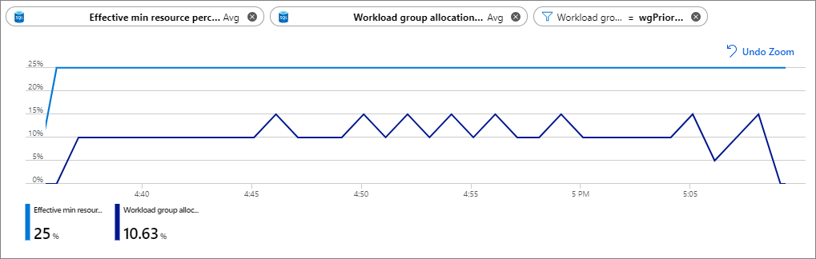
Azure Metrics – Underutilized Workload Isolation
The below chart is configured as follows: Metric 1: Effective min resource percent (Avg aggregation, blue line) Metric 2: Workload group allocation by system percent (Avg aggregation, purple line) Filter: [Workload Group] = wgPriority
CREATE WORKLOAD GROUP wgPriority
WITH ( MIN_PERCENTAGE_RESOURCE = 25
,CAP_PERCENTAGE_RESOURCE = 50
,REQUEST_MIN_RESOURCE_GRANT_PERCENT = 5);
Notes:
From the create workload group statement, we are reserving 25% of system resources at all times for this workload group. We are setting up workload containment by capping resource usage at 50%. Each query in this workload group gets a minimum of 5%, meaning we get minimum guaranteed concurrency of 5 (25/5=5) for this workload group. You could get concurrency of up to 10 if there are resources in the shared pool available after the first 25% is used up.
This is an example where workload isolation has been set up too aggressively. Remember that when you set up Min_resource_percent (viewable by effective_min_resource_percent) it reserved that amount of resources whether or not there are any queries currently running. So in the example here we see that the min_resource_percent was set to 25%, so 25% of the appliance was allocated exclusively for queries that run in this workload group, but the Workload Group Allocated by system percent only shows around 10% system usage out of that 25%. That means the extra 15% configured for isolation is sitting unusable by queries not in this workload group, but is not in use by this workload group.
In this scenario the min_resource_percent for this workload group should probably be lowered to about 10%. Any resources beyond 10% would come from the shared pool of resources outside of this workload group.

Slide 31
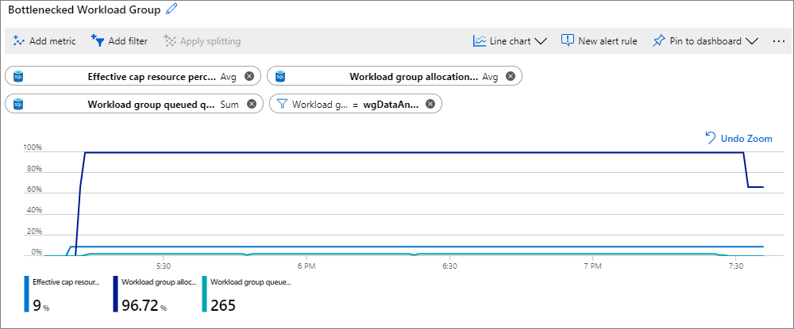
Azure Metrics – Workload Group Bottleneck
Metric 1: Effective cap resource percent (Avg aggregation, blue line) Metric 2: Workload group allocation by max resource percent (Avg aggregation, purple line) Metric 3: Workload group queued queries (Sum aggregation, turquoise line) Filter: [Workload Group] = wgDataAnalyst
CREATE WORKLOAD GROUP wgDataAnalyst
WITH ( MIN_PERCENTAGE_RESOURCE = 6
,CAP_PERCENTAGE_RESOURCE = 9
,REQUEST_MIN_RESOURCE_GRANT_PERCENT = 3);
Notes:
Workload group being created reserves 6% of system resources at all times for this workload group by setting the min_percentage_resource to 6%. Cap_percentage_resource set to 9% means that the workload group can never use more than 9% of system resources. And finally each request gets a minimum of 3%, leaving us with a max concurrency of 3 (9/3=3) within this workload group.
The chart shows that with a 9% cap on resources, the workload group is 90%+ utilized (from the Workload group allocation by max resource percent metric). There is a steady queuing of queries as shown from the Workload group queued queries metric. In this case, increasing the CAP_PERCENTAGE_RESOURCE to a value higher than 9% will allow more queries to execute concurrently. Increasing the CAP_PERCENTAGE_RESOURCE assumes that there are enough resources available and not isolated by other workload groups. Verify the cap increased by checking the Effective cap resource percent metric. If more throughput is desired, also consider increasing the REQUEST_MIN_RESOURCE_GRANT_PERCENT to a value greater than 3. Increasing the REQUEST_MIN_RESOURCE_GRANT_PERCENT could allow queries to run faster.

Slide 32
Catalog Views
Sys.workload_management_workload_groups
User and system workload groups
Sys.dm_workload_management_workload_groups_stats
Effective values of workload groups
Sys.workload_management_workload_classifiers
List workload classifiers
Sys.workload_management_workload_classifiers_details
details of the classifier parameters (label, context, etc)
Notes:
Most of the information you can get out of Azure metrics can be collected from these 4 DMVs. These views do not explicitly hold information like “Workload Group Allocation by Max Resource Percent” although you could probably pull the data together to get that information.

Slide 33
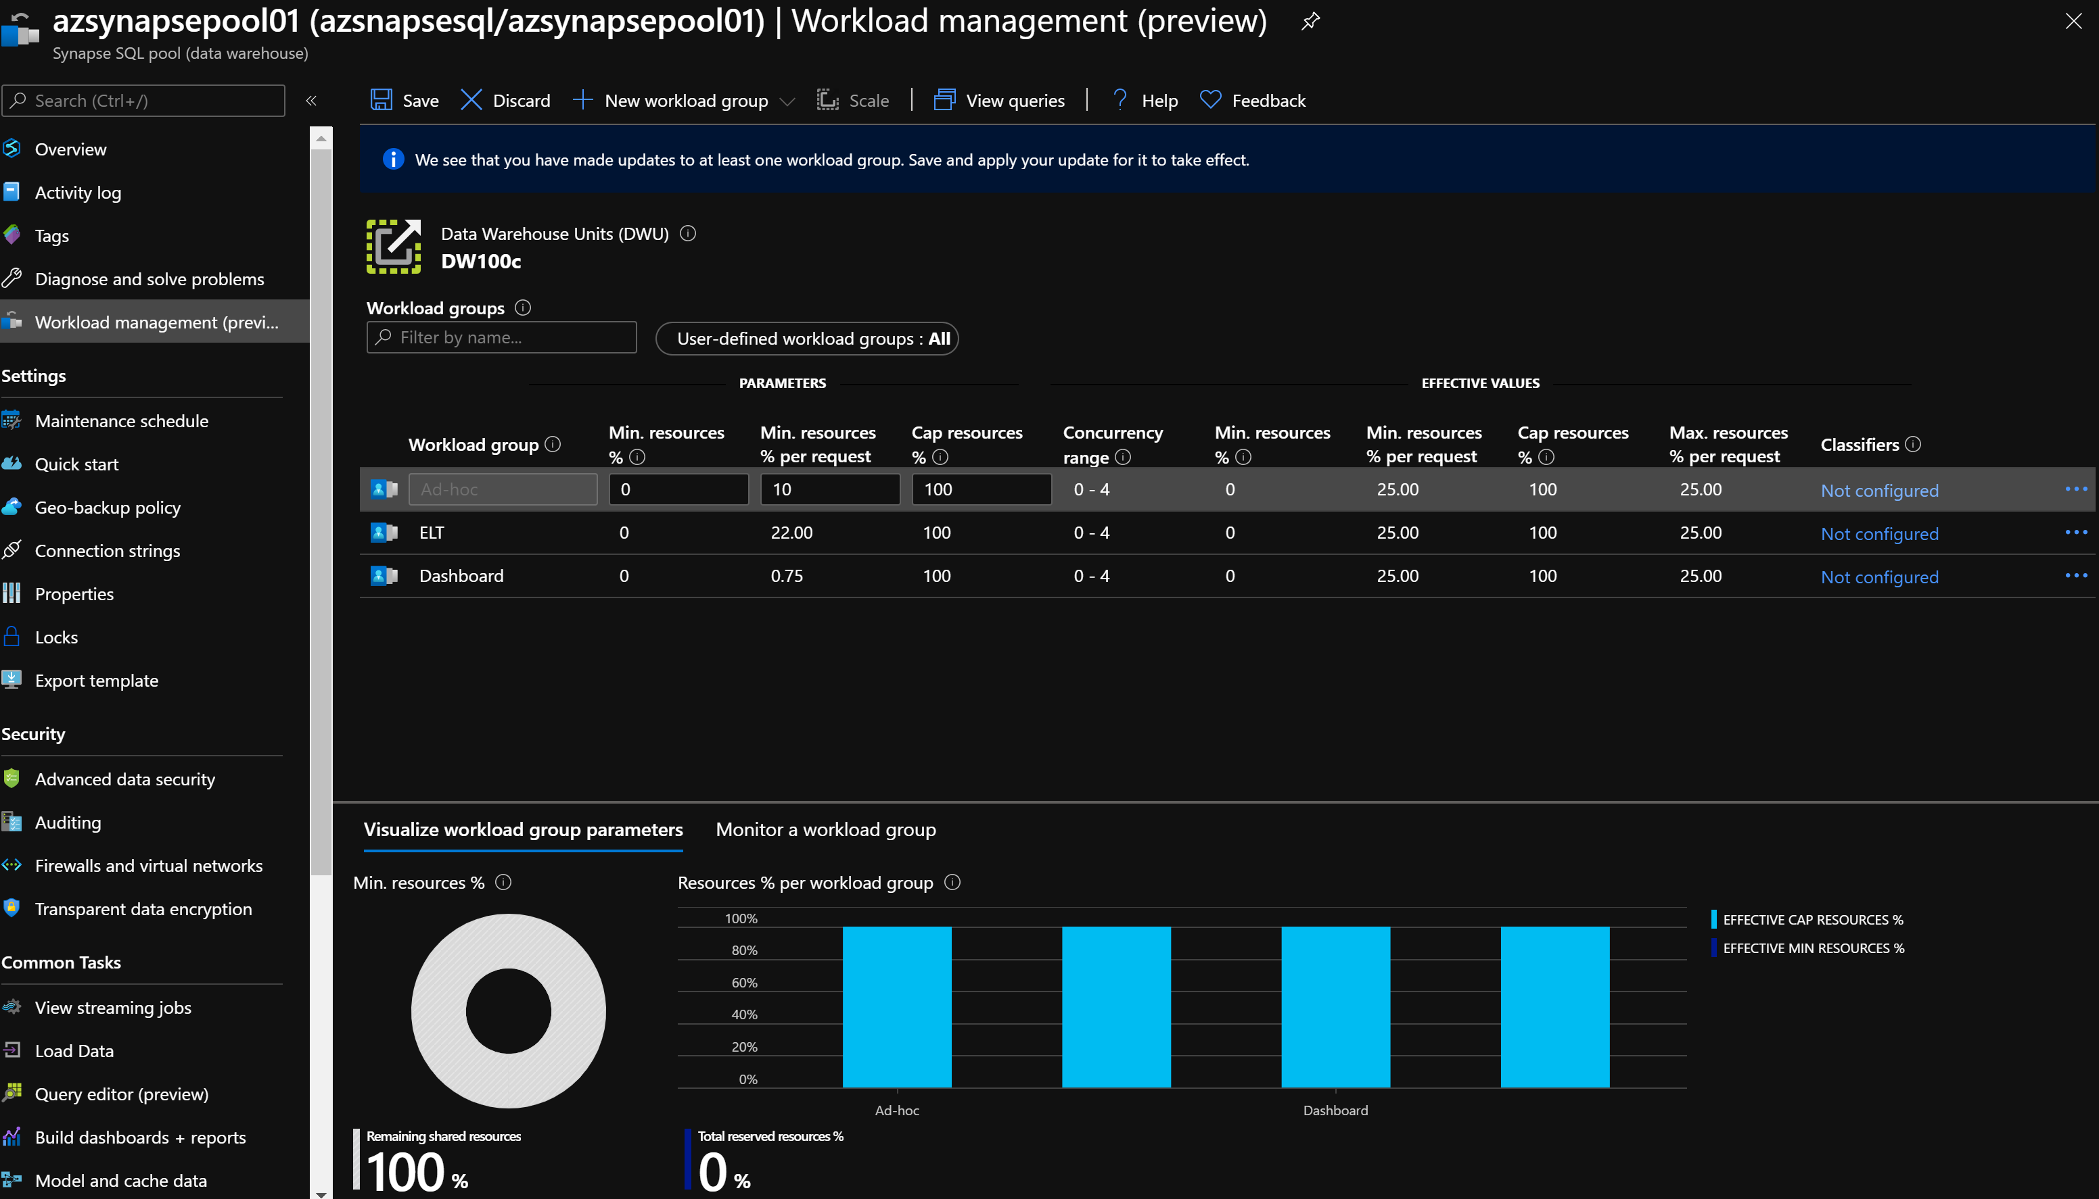
Workload Management Portal Monitoring
Notes:
https://docs.microsoft.com/en-us/azure/synapse-analytics/sql-data-warehouse/sql-data-warehouse-monitor-workload-portal
From the Azure Portal you can view all of your user-defined and system-defined workload groups and their associated classifiers. You can edit the settings of a Workload group here or you can delete or create new classifiers. If you click the ‘new workload group’ button you will be presented with a few example workload groups to get you started. You can later edit the values in these samples to match your workload. This provides you with a very simple way to view your workload management configuration and metrics all from the Azure Portal.

